Slide 1
The Design of Safety Critical Systems
The Design Process
And Requirements

Slide 2
The Design Process
Problem Identification
Research
Requirements and Specification
Concept Generation
Design Phase
System Integration and Test
Maintenance Phase

Slide 3
Royal Academy of Engineering V-diagram
What do the stakeholders want?
REPLACEMENT SYSTEM AT END OF LIFE
Exploit, sustain, and eventually dispose of system
Cost, timescale & risk
What are the possible solutions?
CAPABILITY STATEMENT
USER TESTS
ACCEPTED SYSTEM
Trade-off to define req’ts
Accept system
SYSTEMS TESTS
VERIFIED SYSTEM
REQ’TS SPECIFICATION
Verify system
Iterate to evolve concept design
INTEGRATION TESTS
SYSTEM ARCHITECTURE
SYSTEM
Integrate sub-systems
Create detailed designs
SUB-SYSTEM TESTS
SUB-SYSTEM SPECIFICATION
SUB-SYSTEM
DESIGN & CONSTRUCT SUB-SYSTEMS

Slide 4
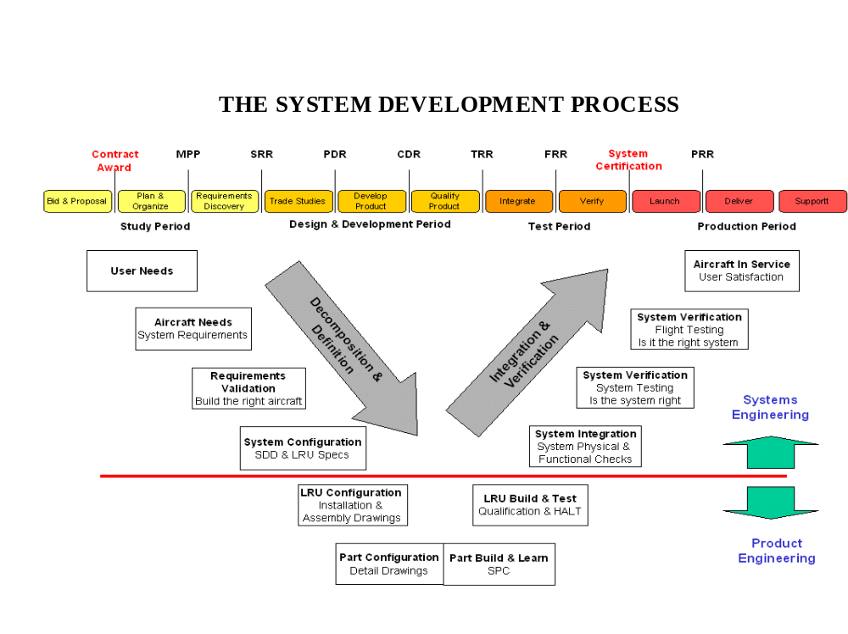

Slide 5
Requirements Process
Requirements discovery
  Interacting with stakeholders to discover their requirements.
Requirements classification and organisation
  Group related requirements and organises them into coherent clusters.
Prioritisation and negotiation
  Prioritising requirements and resolving requirements conflicts.
Requirements documentation
  Requirements are documented

Slide 6
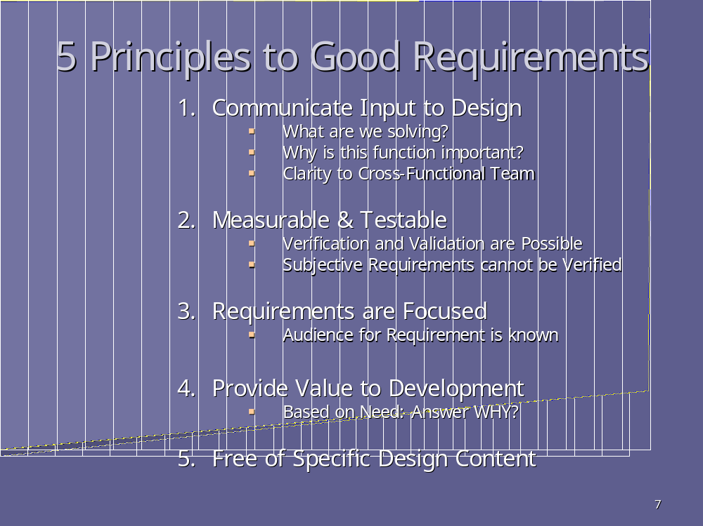
www.incose.org

Slide 7
Requirements
Slide Projector
Customer Requirements:
Good image quality
Easy to transport, Device sets up quickly
Keeps presentation flowing
Image visible in bad conditions
Minimizes unplanned interruptions (reliable)
Attractive product
Engineering Requirements:
Brightness
Weight
Overall dimensions
Time required to set-up
Image distortion
Distance from presenter that device can be operated at
Time to insert/remove slides
Reliability

Slide 8
Requirement Types
There are many ways in which requirements can be classified. However, if we take a systems view a complete and consistent requirements framework comprises:
Operational Requirements
Functional Requirements
Non-functional Requirements
  Non-functional Performance Requirements
  Non-functional System Requirements
  Non-functional Implementation Requirements

Slide 9
Operational Requirements
Operational Requirements defines what the system fundamentally does - its capability (the purpose) together with the key overarching constraints (that define the context)

Slide 10
Functional Requirements
Functional Requirements specify what the system has to DO in order to satisfy the Operational Requirements
For example some of the functional requirements of a civil aircraft are:
- Navigate aircraft
- Manoeuvre aircraft

Slide 11
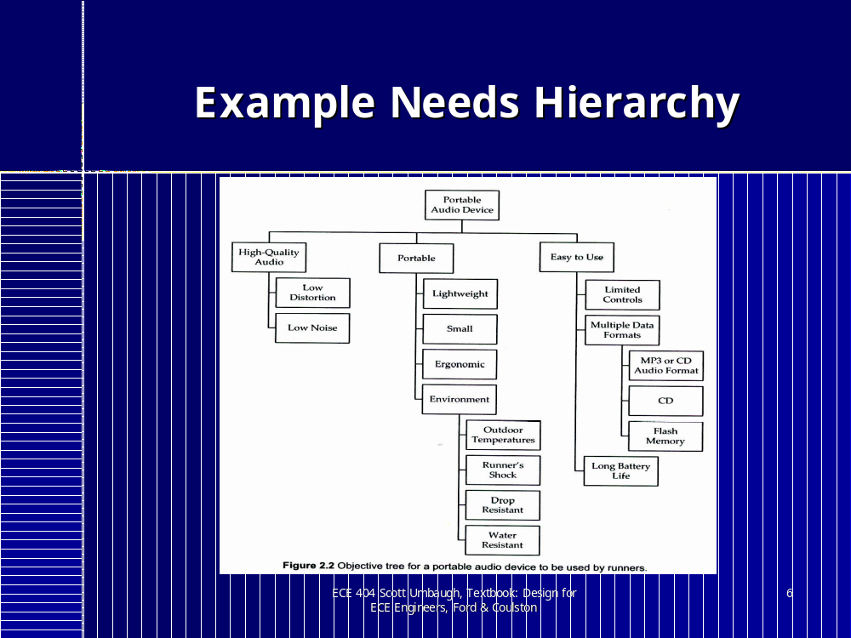

Slide 12
Non-functional Performance Requirements
Non-functional Performance Requirements are associated with corresponding Functional Requirements and define how well a particular function has to perform – they are the constraints on a particular function. Typically they comprise a measure (attribute or property) and a target value

Slide 13
Non-Functional System Requirements
Non-Functional System Requirements define constraints that affect the whole system and include:
Physical Attributes
    System Size
    System Weight etc.
The ilities
  System Reliability
  System Maintainability
  System Interoperability
  System Deployability etc.
System Performance
  System Cost
  System Speed etc.

Slide 14
Non-Functional Implementation Requirements
Non-Functional Implementation Requirements define how a system is to be built in terms of a specific technology. They are solution-based requirements from the customer or legislation
e.g. Pump: 270VDC Electric Pump

Slide 15
Requirements Quality
Good Requirement
The spindle shall rotate at 2.5 +/- 0.1 rad/s
Bad Requirement
The GUI shall be user friendly
Note: the good requirement is only good if the value specified is realistic and not needlessly constraining i.e would 3.0rad/s be satisfactory

Slide 16
Requirements Management
Manage versions and changes.
Store requirements attributes. - person responsible, origin or rationale, release number, status, priority, cost, difficulty, stability, and risk.
Link requirements to other system elements.
Track Status. - good insight into project status.
View requirement subsets.
Control access.
Communicate with stakeholders.

Slide 17
Requirements Management
DOORS: Dynamic Object-Oriented Requirements System
Tool | Vendor | Platforms | Document- or Database-Centric
DOORS 4.1 | Quality Systems and Software Inc. www.qssinc.com | Windows 95 Windows 98 Windows NT, Solaris, Hewlett Packard-UX, IBM AIX, Digital UNIX | Database-centric
RTM Workshop 5.0 | Integrated Chipware www.chipware.com | Windows 95 Windows 98 Windows NT, Unix client; Windows NT or Unix server | Database-centric
RequisitePro 4.0 | Rational Software www.rational.com | Windows 95 Windows 98 | Document-centric
Caliber-RM 1.1 | Technology Builders Inc. www.tbi.com | Windows 95 Windows 98 Windows NT client, Windows NT server | Database-centric
WWW.processimpact.com

Slide 18
Safety Requirements Specification
Functional Requirements: (IEC 61511-1)
Define the safe state
Inputs and trips, outputs and actions, input/output relationships
normal operating parameters
manual shutdown requirements, operator interfaces
actions on loss of power and faults
response times – systems , operators

Slide 19
Safety Requirements Specification
Integrity Requirements: (IEC 61511-1)
SIL Levels for each safety function
Diagnostic coverage required
Maintenance and testing
Proof Test
Environmental Stress

Slide 20
Task: 15 mins
Each Group to produce a set of customer requirements for an Emergency Pram Brake

Slide 21
Design Phase
Robust Project Management
Standards and Processes
Testing including fault injection
Operating Instructions

Slide 22
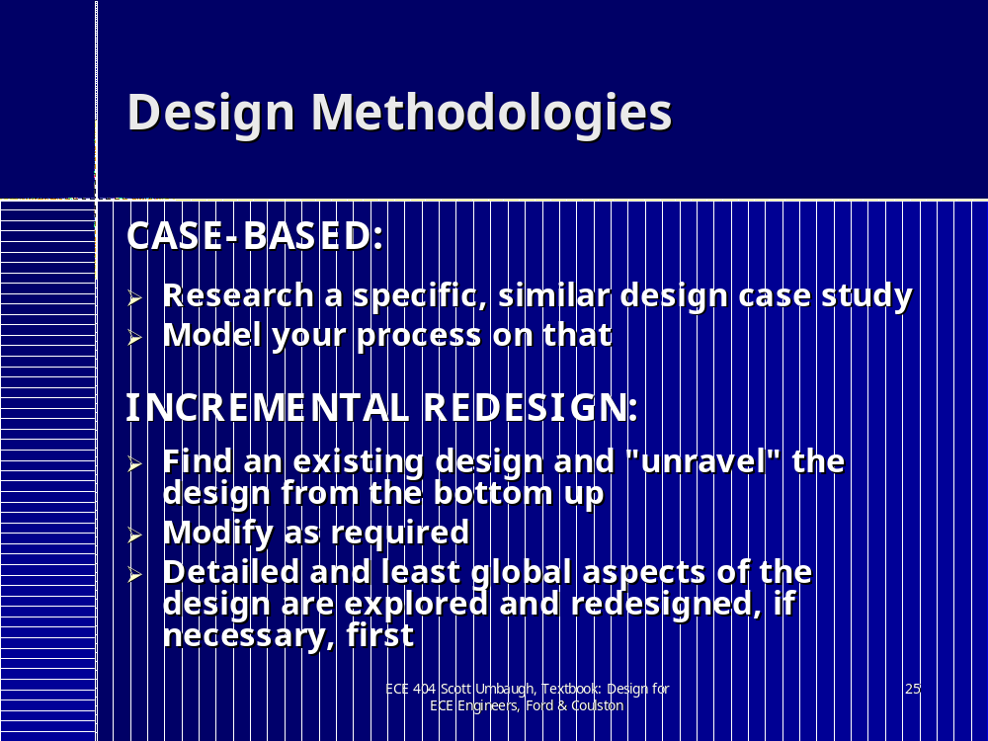

Slide 23
Tonight's Task
Each Group to produce a set of engineering requirements for a pram emergency brake

